Slide 1
AIR TO GROUND RECON SYSTEM
Group 20
Hamza Nawaz – EE
Jerrod Rout – EE
Nate Jackson – EE
William Isidort – EE

Slide 2
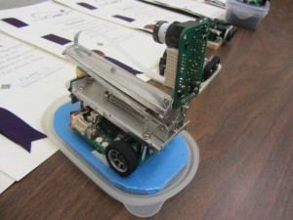
Motivation
Technological boom in Autonomous Vehicles and UAVs
Search & Rescue/Search & Destroy Missions
Good Project for Developing our Programming Capabilities
Extension of Robotics Project
MM-7A by Shinichi Yamashita
Micromouse Competition

Slide 3
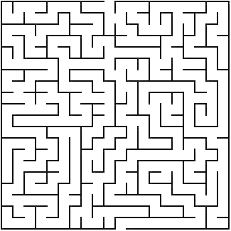
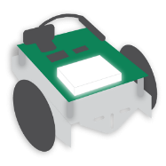
Maze Solver Overview
Video Transmission
Entrance
Exit
Vehicle Commands

Slide 4
Goals & Objectives
Lightweight – Both the UAV and the ground vehicle must be light enough to be easily transported on foot.
Operating Duration – Limited by battery life and weight of each vehicle since both must be functioning in order to solve the maze.
Wall Detection – Walls of the maze must be detectable by both the ground vehicle and computer vision techniques.
Object Detection – A “goal” object placed in the maze will be located by the ground vehicle.
Maze Solving – Algorithms will be used to solve the maze image and navigational cues will be sent to the ground vehicle.

Slide 5
Requirements & Specifications
Component | Parameter | Specification
Camera | Resolution | 640 x 480 pixels
Wireless Video Transmitter | Range | Min. 50 ft.
RF Transceivers (XBee modules) | Range, Data Transfer Rate | Min. 50 ft., 100kbps
Quadcopter | Weight, Battery Life | Max 5 lbs., 30min
Ground Vehicle | Weight, Battery Life, Speed | 5 lbs., 30 min, 1ft/sec

Slide 6
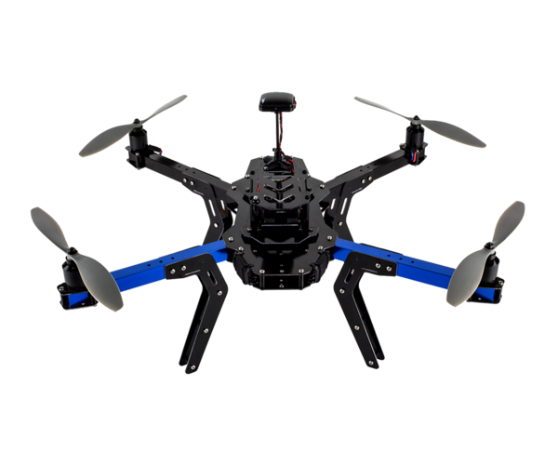
Quadcopter
3DR DIY Quadcopter which was provided by Dr. Richie

Slide 7
Video Transmission
Live feed from the quadcopter will be used as an input to our maze solving program.
Will be transmitting at a 5.8 GHz Frequency, at no more than a range of 100 ft.
The receiving signal will be fed through an analog to digital video converter in order for OpenCV to use the live stream from the camera as an input.
Camera
Video Transmitter
Video Receiver
A/D Video Converter
USB Input to PC

Slide 8
Camera
GoPro Hero 3+
Company | GoPro
Battery Life | 2 hours
Price | $100
Weight | 135g
Resolution | 1080p, 60 FPS

Slide 9
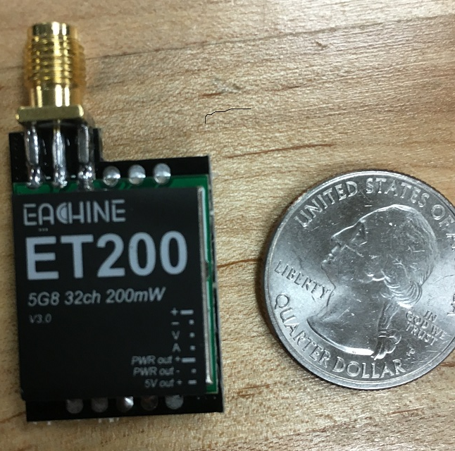
Video Transmitter
Company | Eachine
Operating Voltage | 7-24V
Channels | 32
Price | $40
Weight | 15g (with antenna)
Frequency | 5.8GHz
Power Output | 200mW

Slide 10
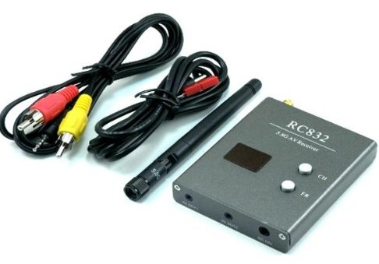
Video Receiver
RC832 Receiver
Company | Eachine
Operating Voltage | 12V
Channels | 32
Price | $36.99
Weight | 85g (with antenna)
Frequency | 5.8GHz
Working Current | 200mA

Slide 11
Software

Slide 12
Library and IDEs
Visual Studio 2010 Ultimate IDE
XNA Game Development Framework
Emgu CV - .Net wrapper for OpenCV Image Processing Libraries
Windows 7 OS

Slide 13
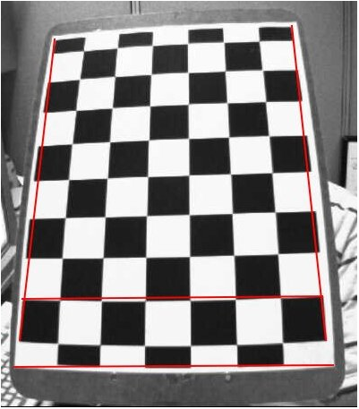
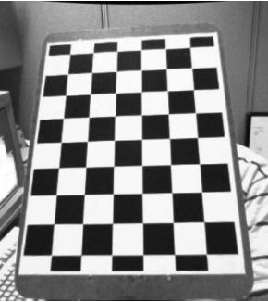
Detecting the Maze
Correct perspective and scaling issues that arise due to vantage point snapshot is taken from.
Remove camera distortion (if any).
Find bounds of maze and crop image.

Slide 14
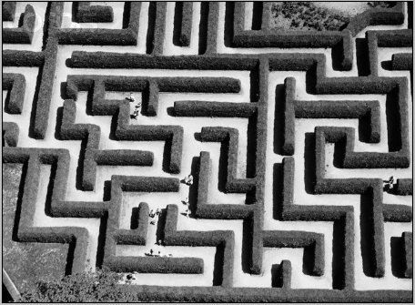
Binary Thresholding
Once the bounds of the maze have been determined, we will need to separate the walls of the maze from the floor and create a binary image.
Binary Thresholding can be combined with noise reduction techniques to produce a binary image.
Original Grayscale Image
Binary Image with Noise
Binary Image after Closing

Slide 15
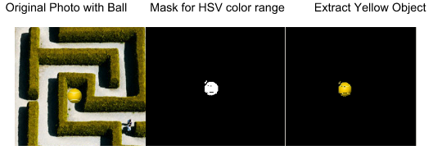
Locating an Object in the Maze
In our application the goal is to locate an object inside a maze and have the ground vehicle navigate towards it.
This object can be detected by using color thresholding to filter the image for a specific range of colors.
The first step is to convert the original BGR image to HSV colorspace. HSV separates intensity from color information which reduces the effect of lighting conditions.
Next, thresholds are chosen which filter out a specified range of hues.

Slide 16
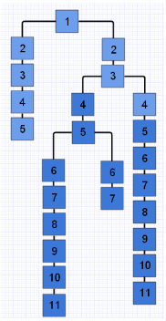
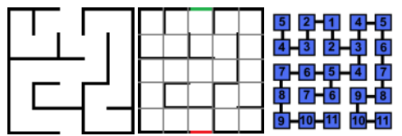
Binary Image Conversion
Once the walls and floor of the maze have been separated, the binary image will need to be transformed into an abstract data structure that can be solved.
We will iterate through every pixel in the binary image and create a list of only floor pixels. These pixels will be grouped into sections of the maze (nodes) and added to a new list.
These nodes will then be linked together to form a tree structure by using an adjacency matrix.

Slide 17
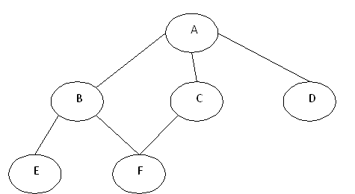
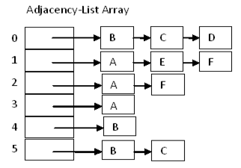
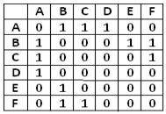
Linking the Nodes
Nodes can be linked to one another through “edges”.
Edges can be represented by using an adjacency matrix (2D array of boolean flags) or an array of linked-list nodes.

Slide 18
Preliminary Image Conversion

Slide 19
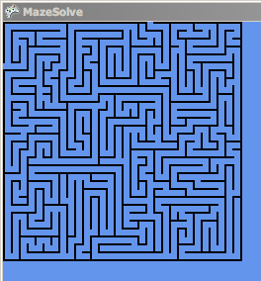
Preliminary Image Conversion

Slide 20
Solving the Maze
We are going to implement the BFS algorithm because it explores a node’s neighbors before moving to the next level on a branch. This algorithm explores the maze in parallel, while DFS explores the maze sequentially or path-by-path.
BFS will enable the shortest path to be found and allows a braid-type maze to be solved.
An alternative would be to use A* which offers the same performance as BFS but requires fewer nodes to be explored.
Generate vehicle commands to sent to ground vehicle.

Slide 21
Wireless Communication

Slide 22
Wireless Technologies
Bluetooth | Wi-Fi | Zigbee
Easy to set up | Easy to set up | Easiest to set up
Low power consumption | Higher power consumption | Low power consumption
Low Range | Long Range | Long range
Sufficient Bandwidth | Sufficient Bandwidth | Sufficient Bandwidth

Slide 23
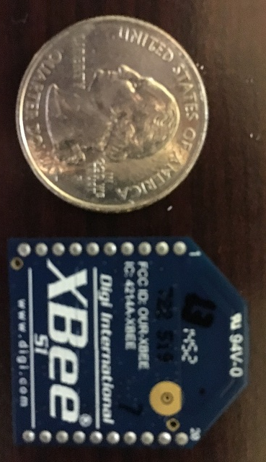
Wireless Communication
XBee (802.15.4) 1mW w/ Trace Antenna will be used for wireless RF communication between the computer and ground vehicle.
Operating Voltage / Transmit Current | 3.3V / 50mA
Price | $24.95
Data Transfer Rate | 250kbps
Range | 300ft (Outdoors)
Transmit Power output | 1mW
I/O | 6 Digital I/O, 6 ADC Input Pins
Frequency | 2.4 GHz

Slide 24
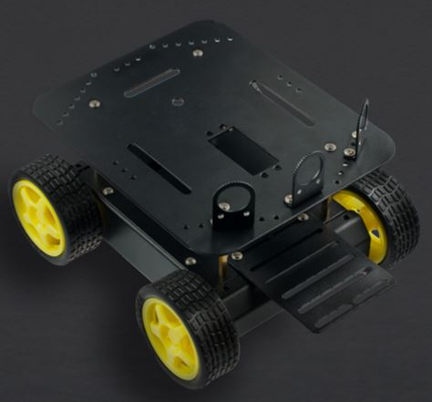
Ground Vehicle Design
Pirate 4WD Robot Platform
Dimensions | 200 x 170 x 105 mm
Power Supply Voltage | 7.5 V
Battery Life | 1.5 hours
Recharge Time | 10 hours
Weight | 45 g
Minimum Speed | 0.5 m/s
Maximum Speed | 1 m/s

Slide 25
Processor Selection
 | AM3359 Sitara | ATmega328 | MSP430G2553 | PIC16F690
Architecture | 32-Bit RISC | 8-Bit RISC | 16-Bit RISC | 8-Bit RISC
Frequency | 800 MHz | 20 MHz | 16 MHz | 20 MHz
I/O Supply Voltage | 1.8 V-3.3 V | 1.8 V-5.5 V | 1.8 V-3.6 V | 2 V-5.5 V
Code Storage | 64 KB OCMC RAM | 16 KB FLASH | 16 KB Non-volatile | 7 KB Flash
I/O Pins | 4 Banks x 32 GPIO Pins | 28 Pin PDIP | 80 GPIO Pins | 18 I/O Pins
Development Board | BeagleBone Black | Arduino Uno, DueMilanove, etc. | MSP430 Launchpad | Explorer 8 Development Kit, etc.

Slide 26
Microcontroller
ATmega328
32 KB of In-System Self-Programmable Flash Program Memory
1 kB EEPROM
2 KB Internal SRAM
Programmable Serial USART
Master/Slave SPI Serial Interface
I²C Compatible

Slide 27
Power Supply
$Optimal Discharge Rate:$
$200mA+4∙170mA=880mA$
$C−rate:$
$\frac{2300mAh}{1A}=2.3 Hours$

Slide 28
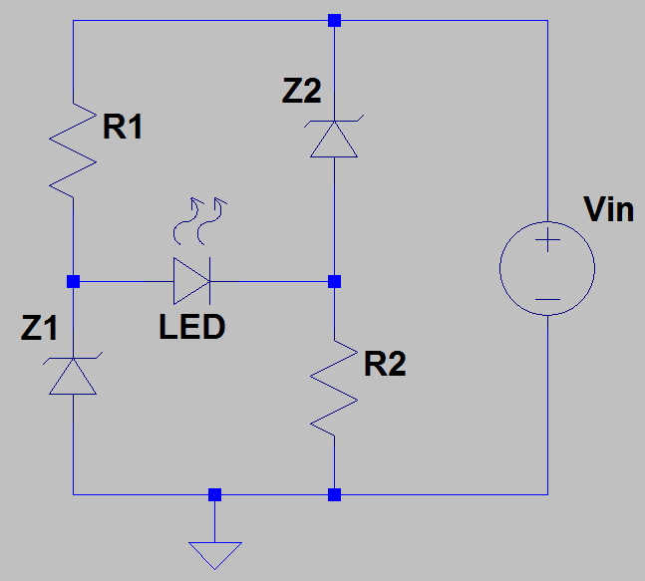
Power Supply Circuitry
Switching Regulator Circuit
Low-Voltage Indicator Circuit
Recommended Minimum of 7V and a Critical Lower Limit of
6V; Low-Voltage Indicator Circuit will help Damage from
Inadequate Power
PCB Has a Critical Upper Limit of 12V; Buck Regulator

Slide 29
Embedded System Program Flow
Processor accepts command string with 3 types of remote commands (forward, left, right) and inputs them into MCU serial buffer
Cycles through all the commands using a switch statement.
Forward commands stops if given too many using front ultrasonic sensor to avoid wall collision.
Ground Vehicle goes forward or turns based on remote sensing, if vehicle stops short before turn, the turn command senses the wall until it can perform the turn to avoid wall collision.
Side ultrasonic sensors allow for path correction to avoid wall collissions, depending on the distance the two sensors read.

Slide 30
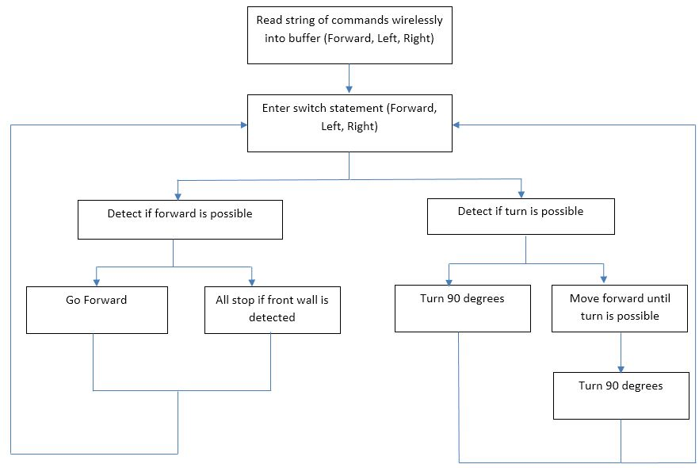

Slide 31
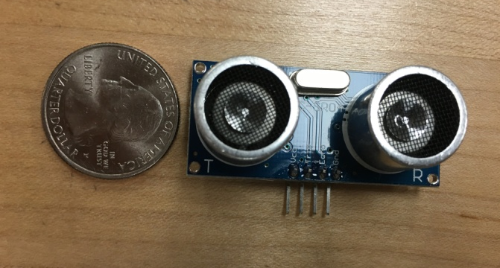
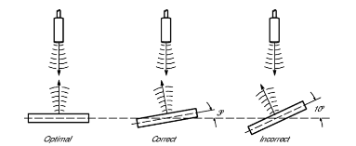
Ultrasonic Sensors
Cost (5pcs.) | $8.69
Operating Voltage | 5V
Supply Current | 15mA
Power Consumption | 75mW
Range | 2-500cm
Weight | 15g
Several HC-SR04 proximity sensors will be used to prevent the ground vehicle from crashing into the walls of the maze.
Unlike Infrared sensors, their measurements are not affected by optical reflectivity and color of the target.

Slide 32
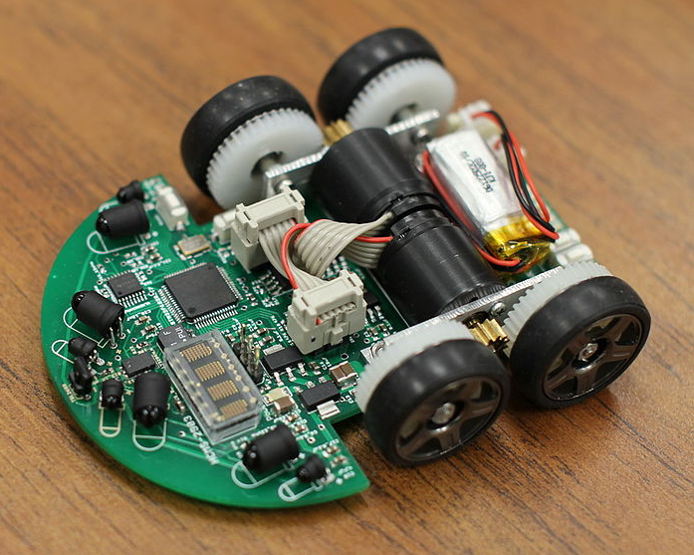
Prospective Design Improvements
PCB Chassis
Much Smaller in Size
More accurate Turning
Better Power Efficiency

Slide 33
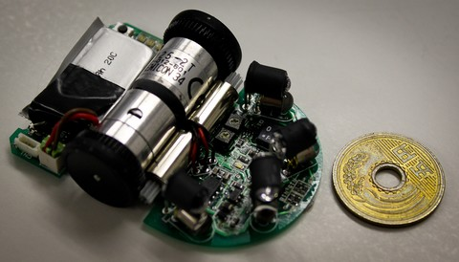
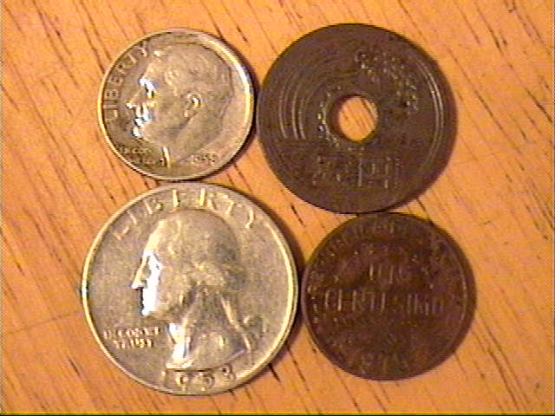
PCB Chassis

Slide 34
Administrative Content

Slide 35
Sponsors
We’d like to thank Boeing and Leidos for funding our project and the UCF EECS department providing us with hardware.

Slide 36
Budget
Part | Purchaser | Quantity | Cost | Total Cost (Include tax+shipping when ordered)
SD1 Documentation | Hamza | 1 | $ 47.98 | $ 47.98
XBee Module | Hamza | 2 | $ 24.95 | $ 58.52
Xbee Explorer Dongle | Hamza | 1 | $ 24.95 | $ 24.95
Turnigy 9XR Pro Transmitter | Nate | 1 | $ 80.97 | $ 80.97
FrSky DJT radio module | Nate | 1 | $ 41.35 | $ 41.35
FrSky D4R-II Receiver | Nate | 1 | $ 27.88 | $ 27.88
Turnigy 2200mAh LiPo | Nate | 1 | $ 18.96 | $ 18.96
HC-SR04 Ultrasonic sensor | Nate | 6 | $ 1.10 | $ 10.10
RedBot Wheel Encoder | Nate | 1 | $ 4.95 | $ 4.95
Arduino | Hamza | 1 | $24.95 | $ 24.95
Video Converter | Hamza | 1 | $ 33.99 | $ 33.99
Camera + Transmitter | Hamza | 1 | $ 39.99 | $ 39.99
Video Receiver | Hamza | 1 | $ 36.99 | $ 36.99
Maze Materials | Will | 1 | $95 | $ 95.00
Quadcopter Repair | Will | 1 | $150 | $ 150.00

Slide 37
Division of Labor
 | Embedded Pr. | Power/ UAV | Communication | Software
Hamza
Nate
William
Jerrod

Slide 38
Progress

Slide 39
Questions?

